Slide 1
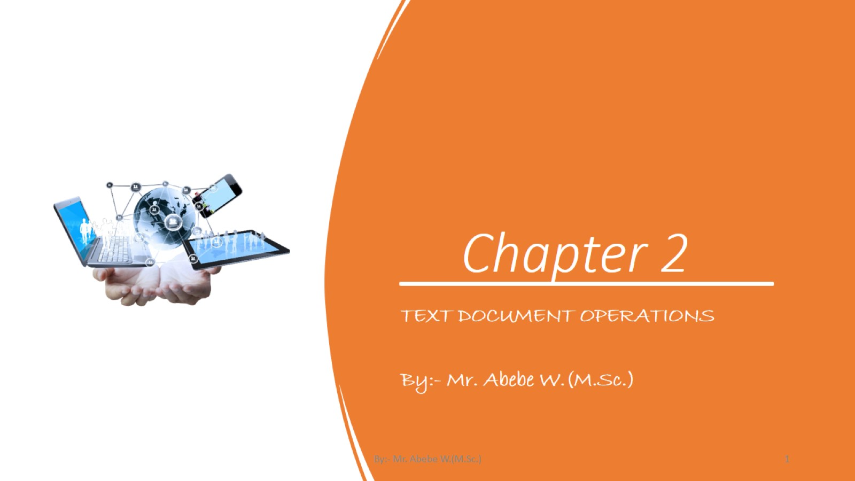
Chapter 2

Slide 2
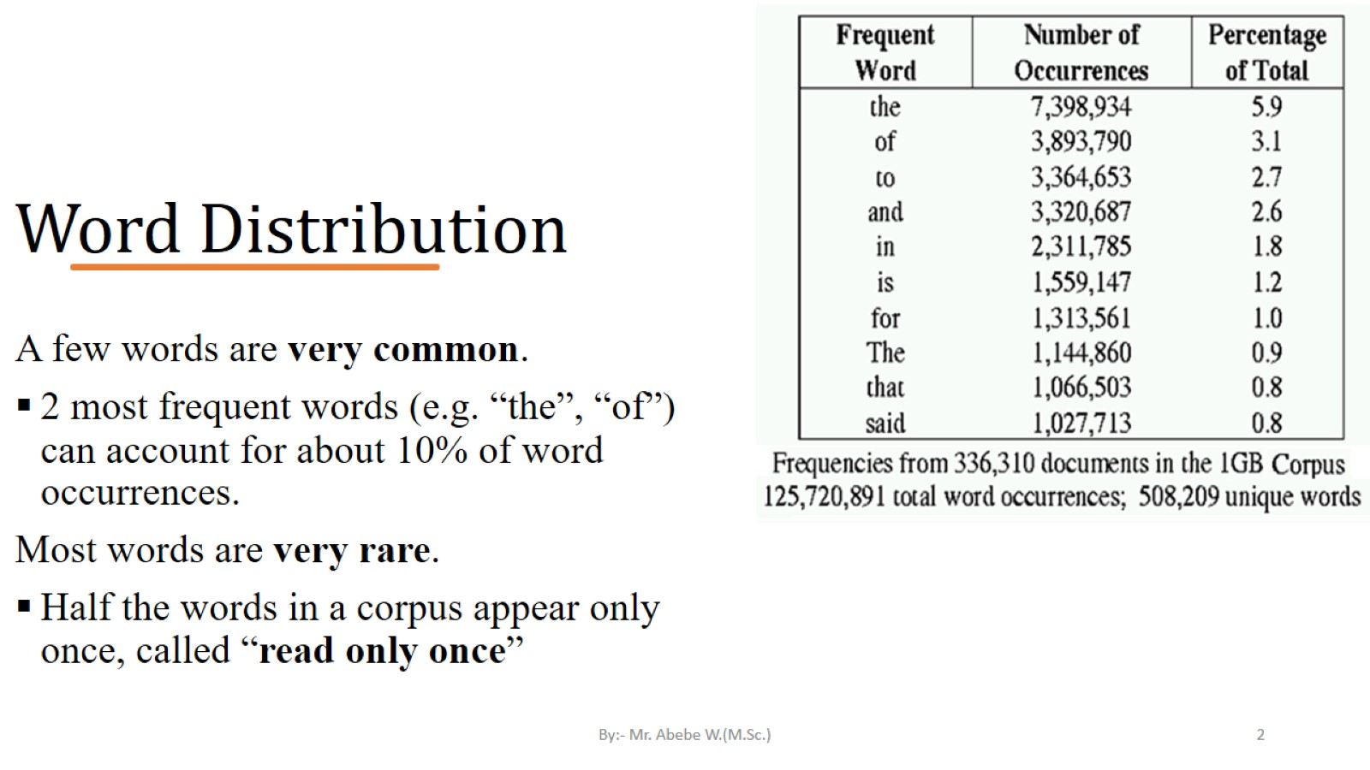
Word Distribution

Slide 3
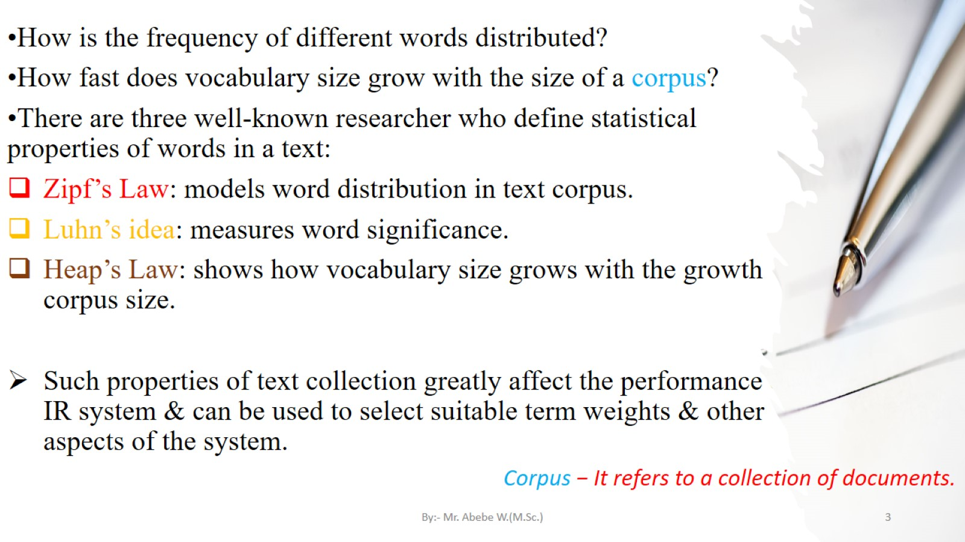

Slide 4
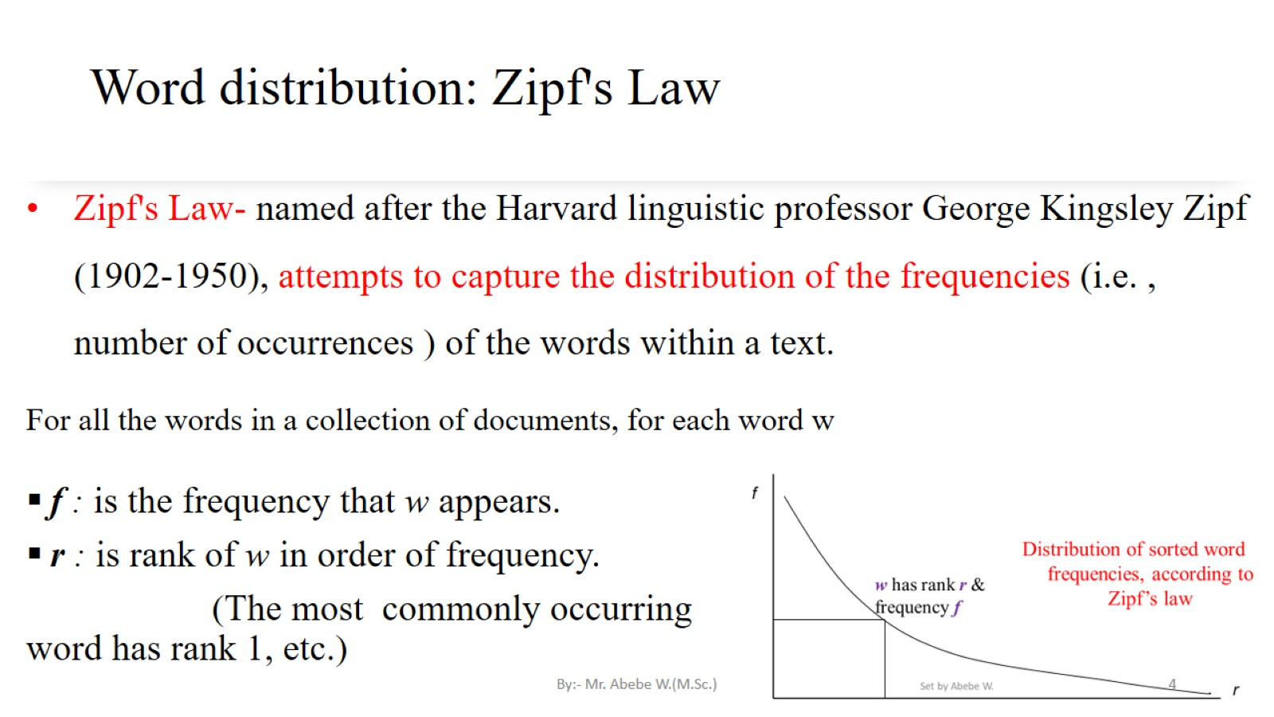
Word distribution: Zipf's Law

Slide 5
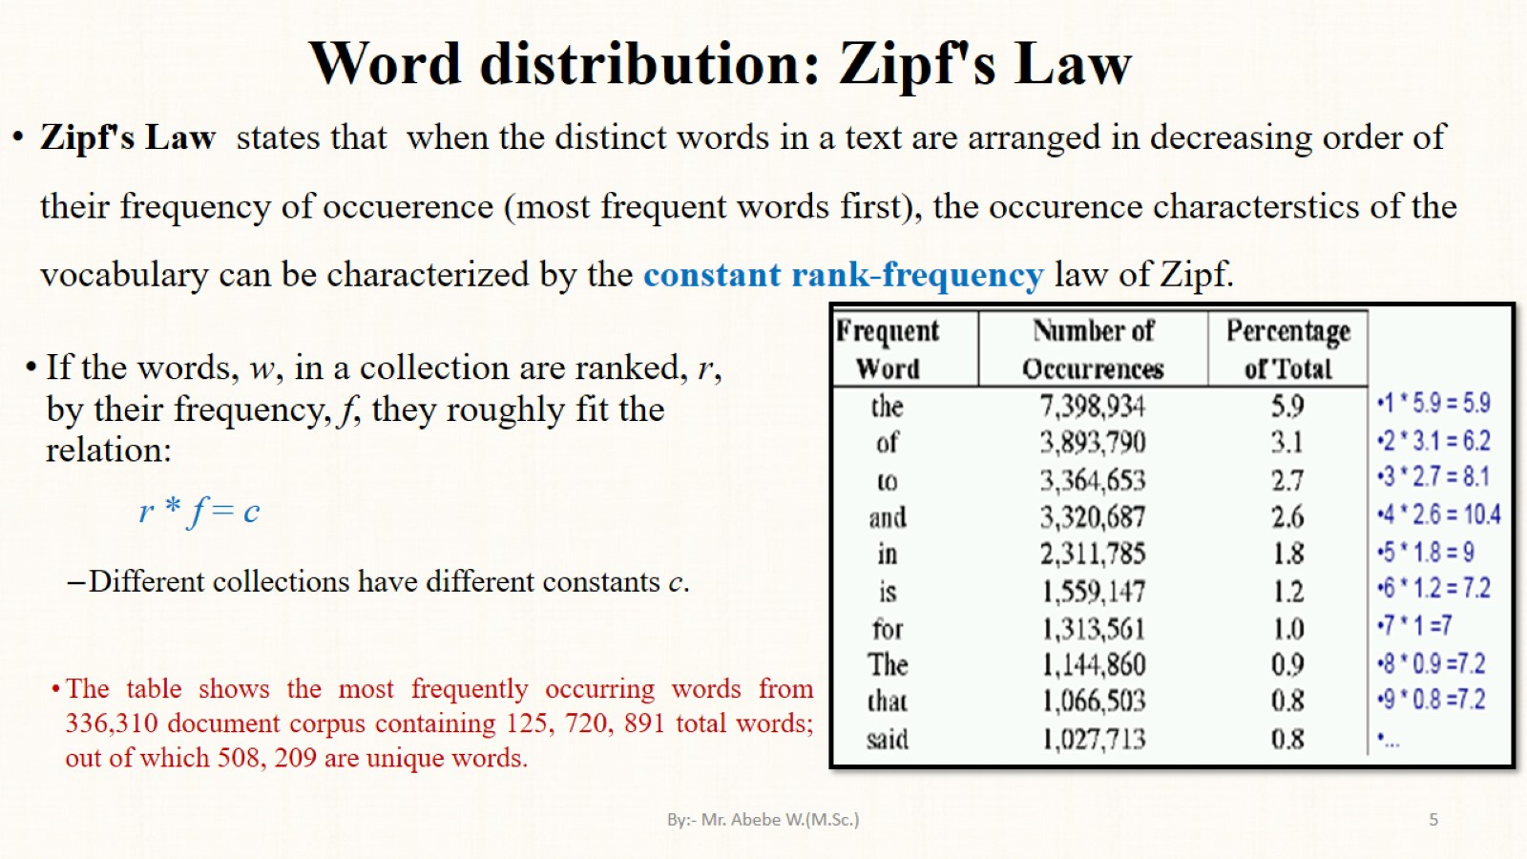
Word distribution: Zipf's Law

Slide 6
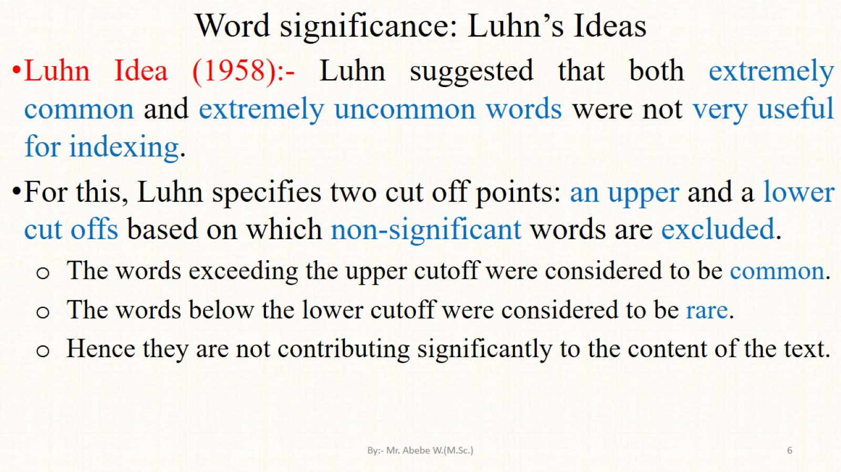
Word significance: Luhn’s Ideas

Slide 7
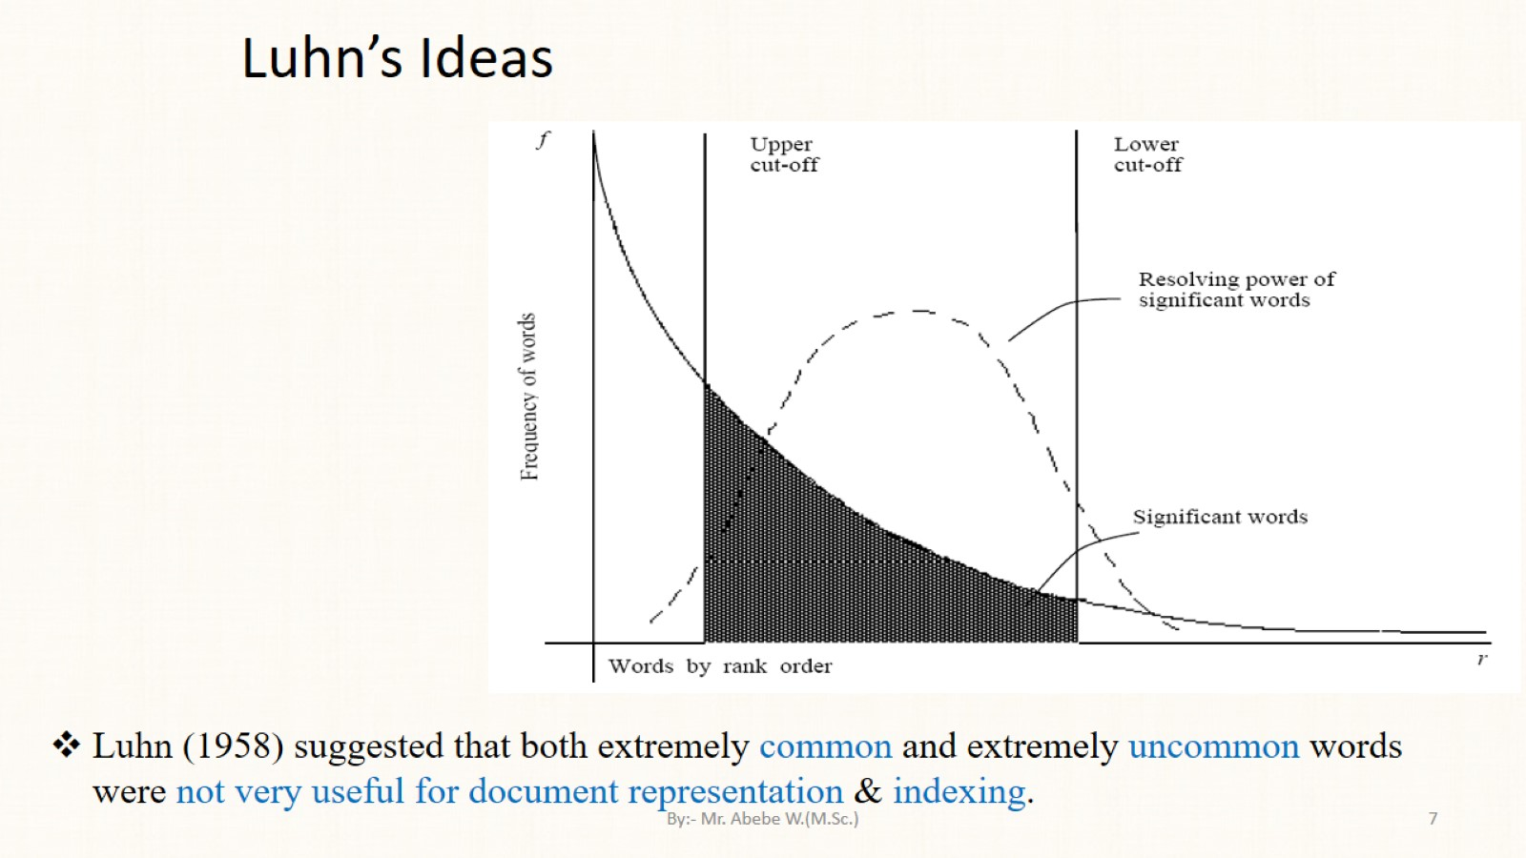
Luhn’s Ideas

Slide 8
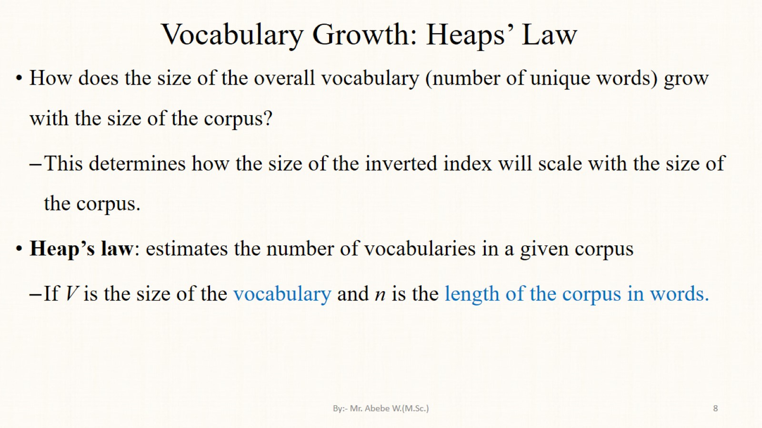
Vocabulary Growth: Heaps’ Law

Slide 9
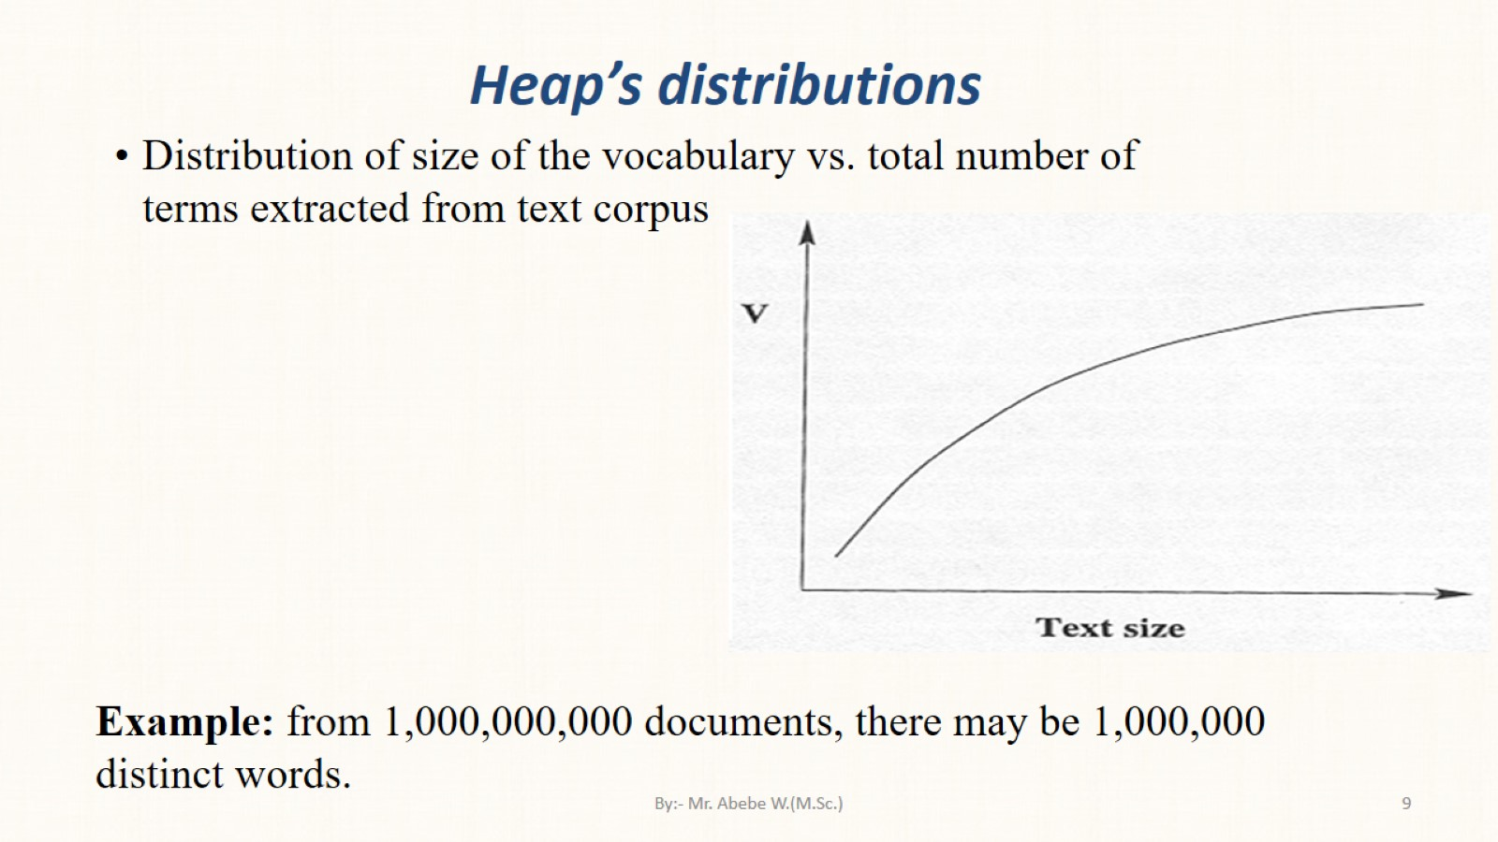
Heap’s distributions

Slide 10
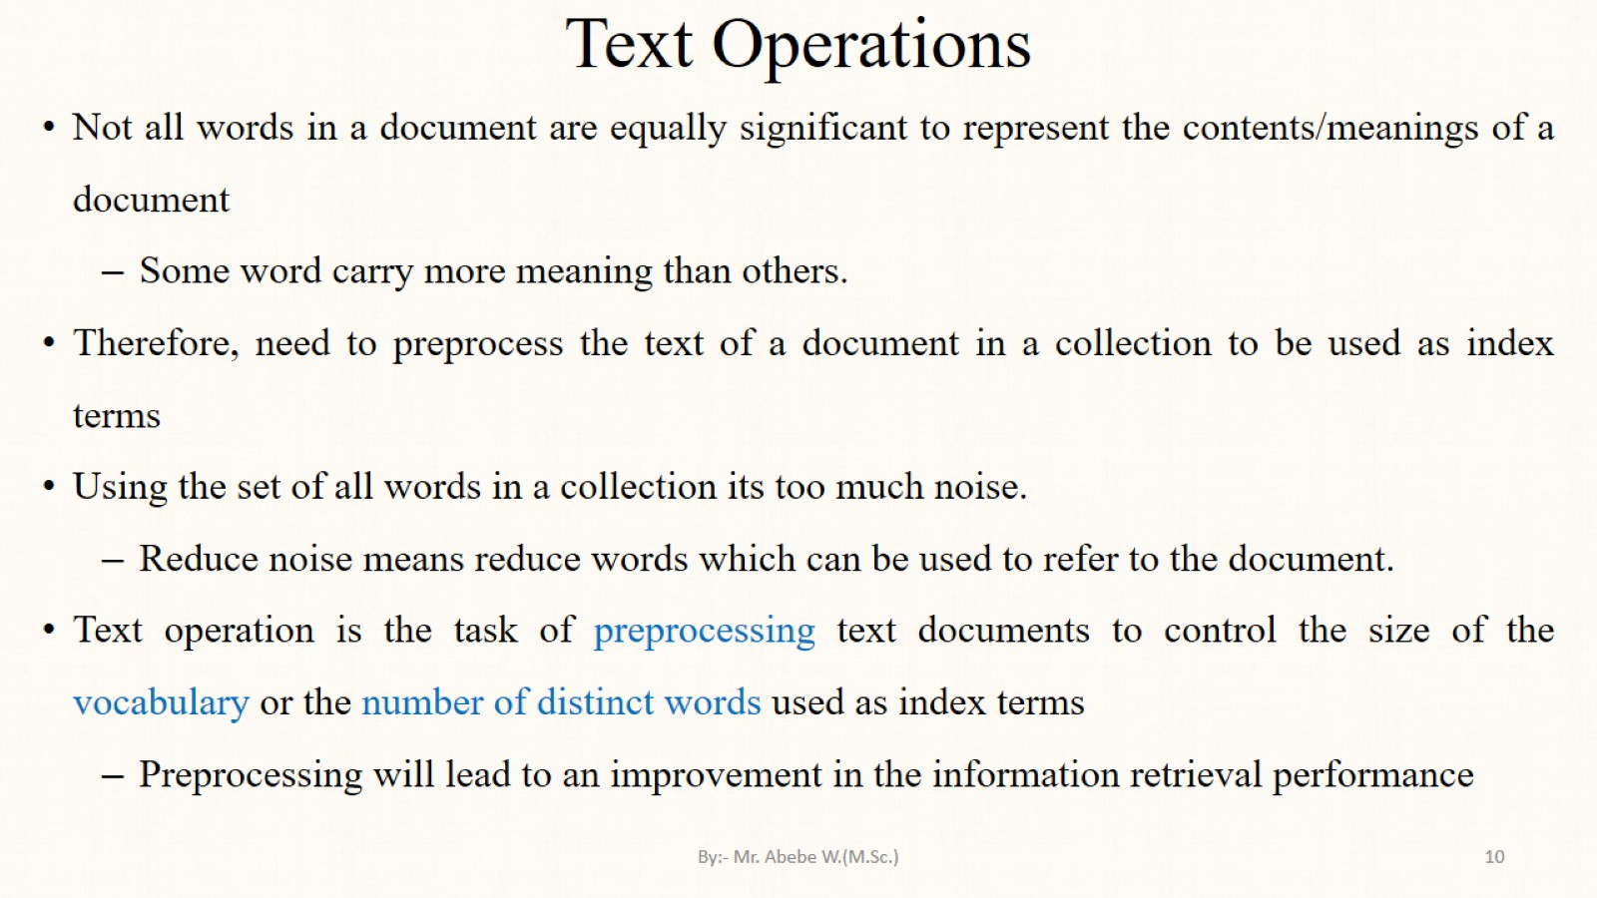
Text Operations

Slide 11
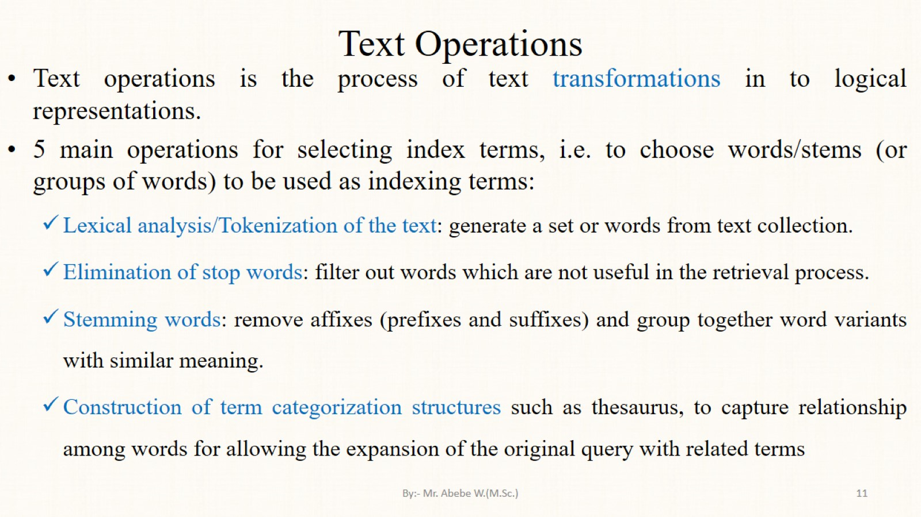
Text Operations

Slide 12
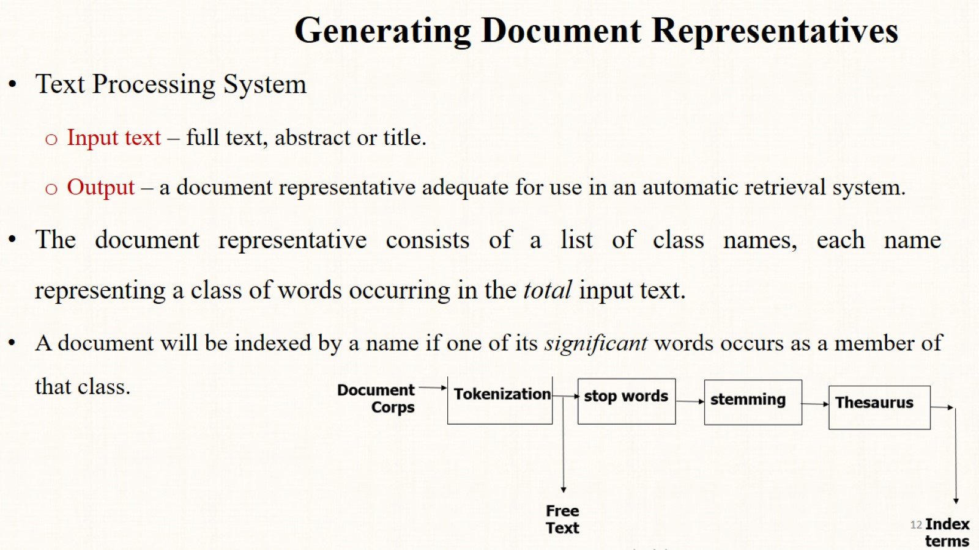
Generating Document Representatives

Slide 13
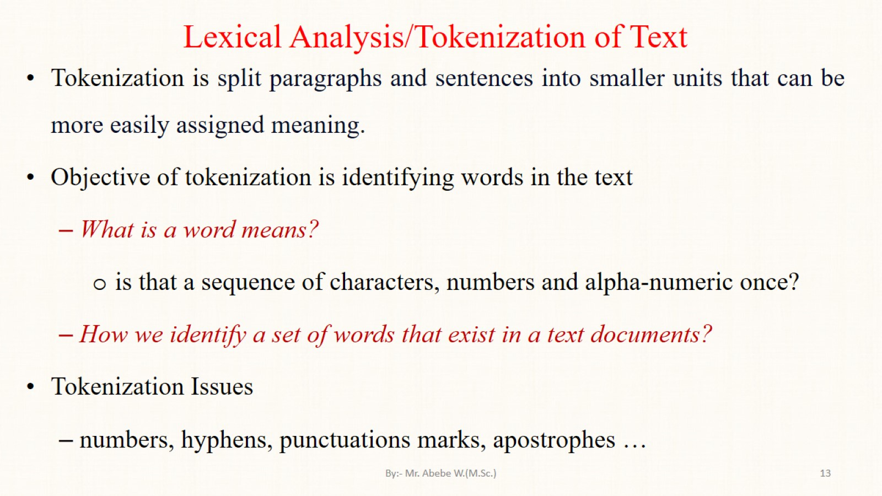
Lexical Analysis/Tokenization of Text

Slide 14
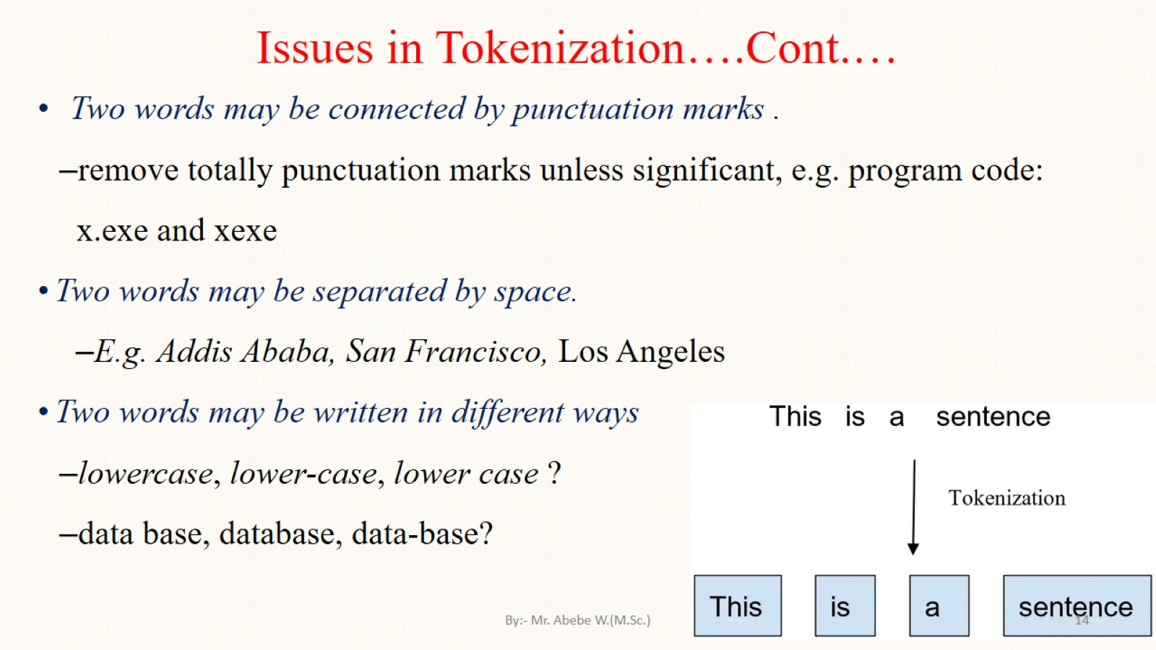
Issues in Tokenization….Cont.…

Slide 15
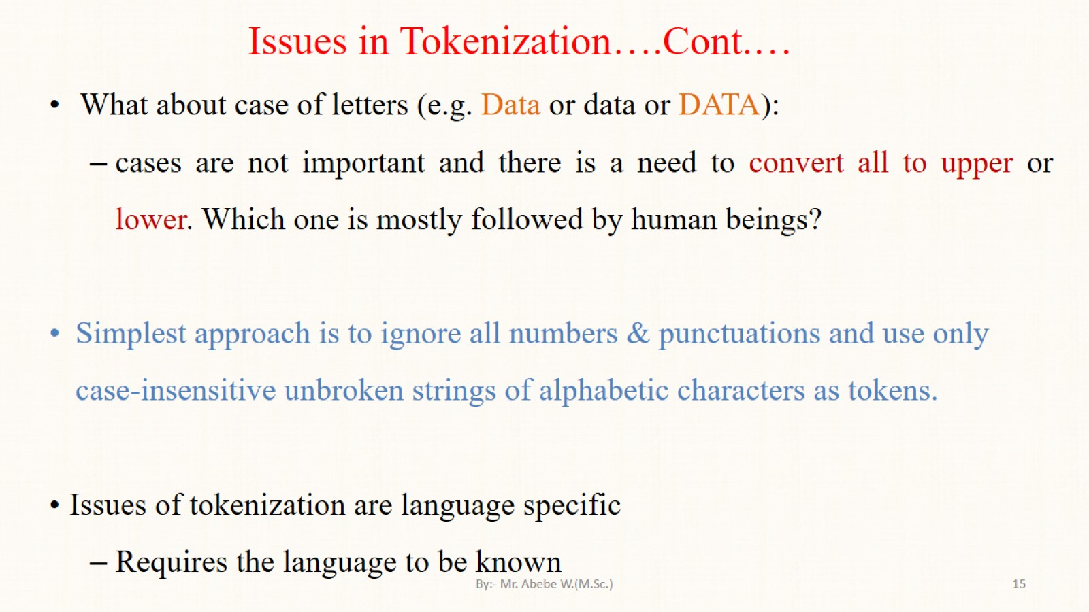
Issues in Tokenization….Cont.…

Slide 16
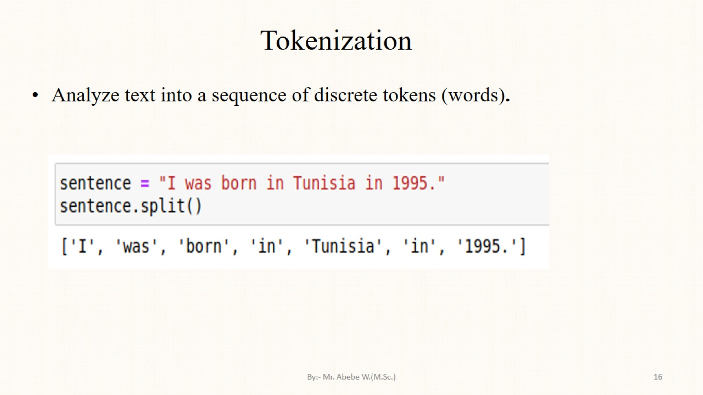
Tokenization

Slide 17
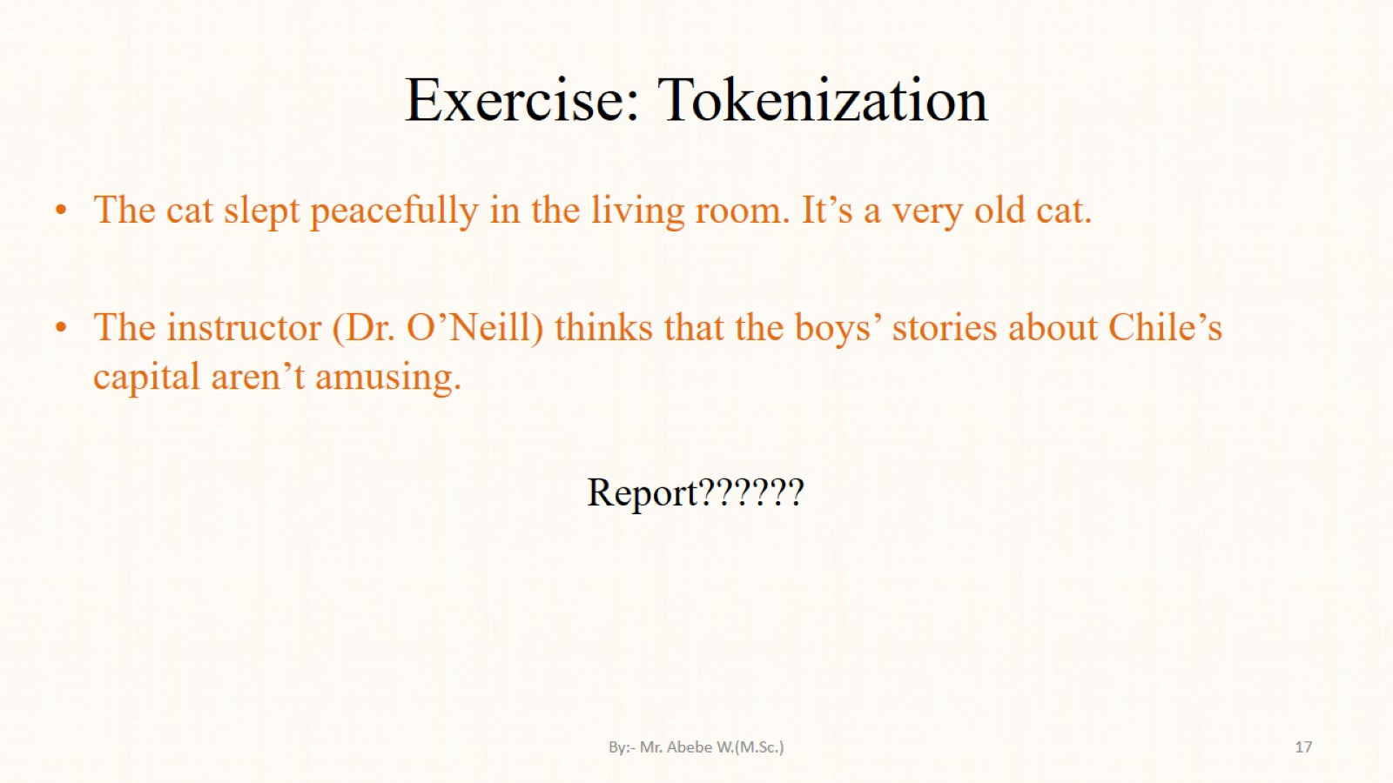
Exercise: Tokenization

Slide 18
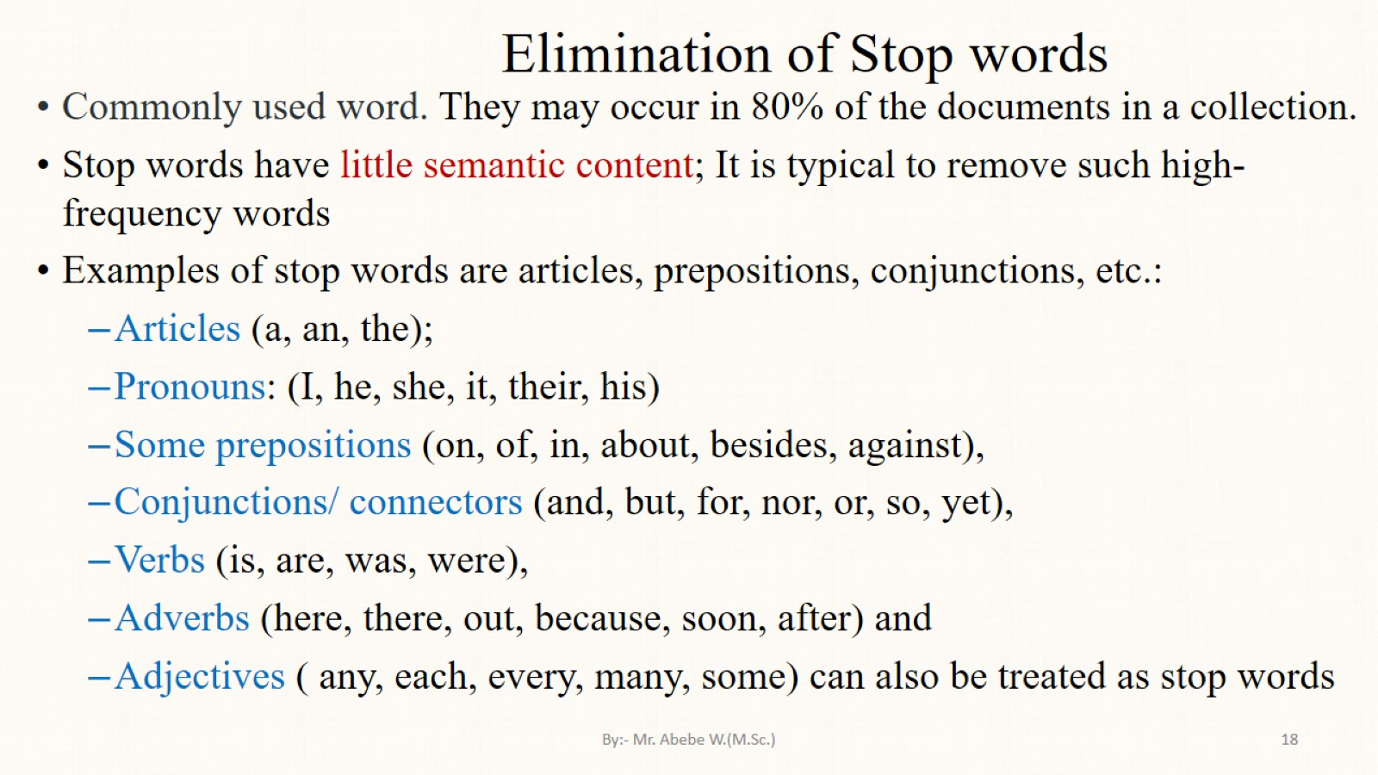
Elimination of Stop words

Slide 19
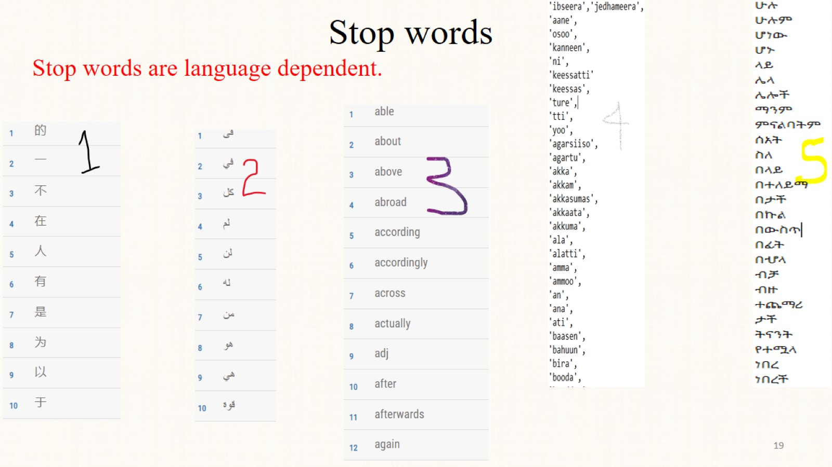
Stop words

Slide 20
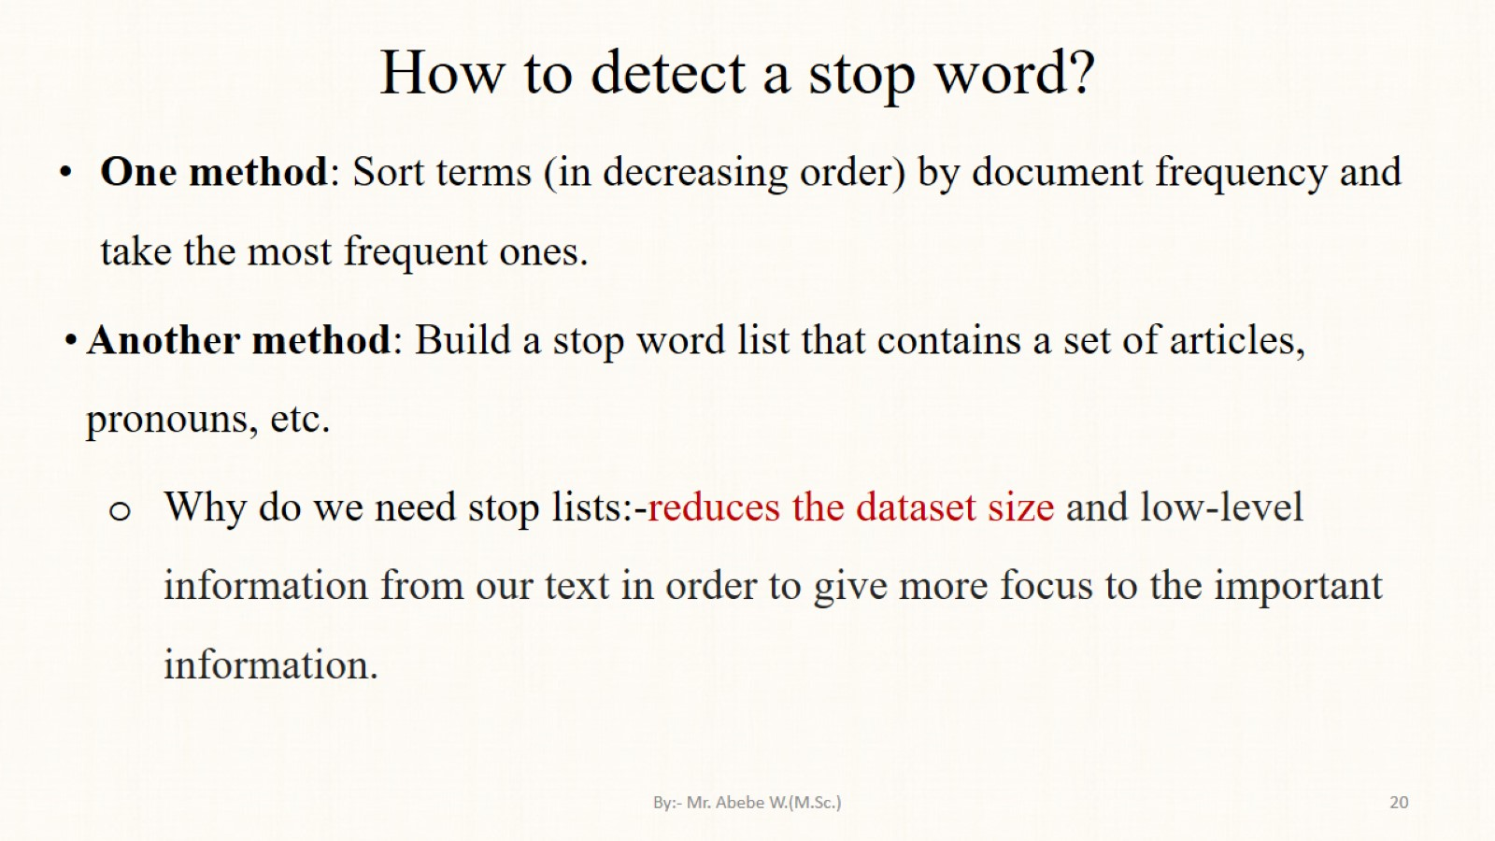
How to detect a stop word?

Slide 21
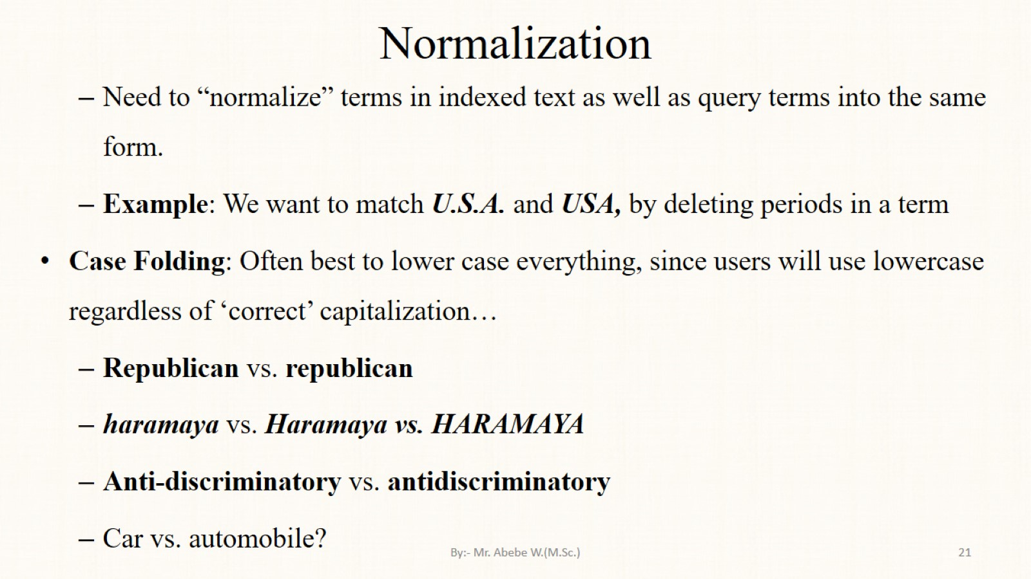
Normalization

Slide 22
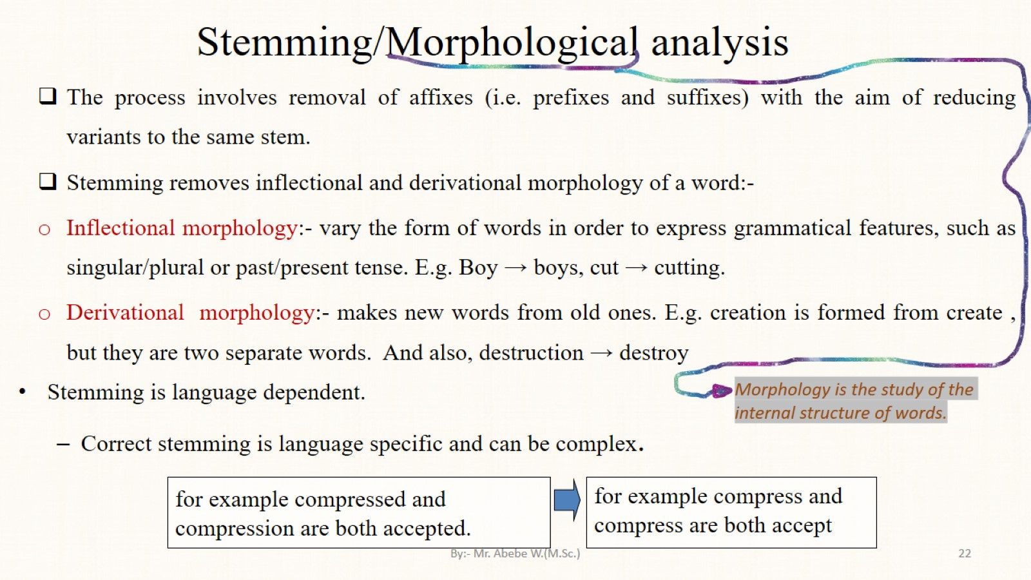
Stemming/Morphological analysis

Slide 23
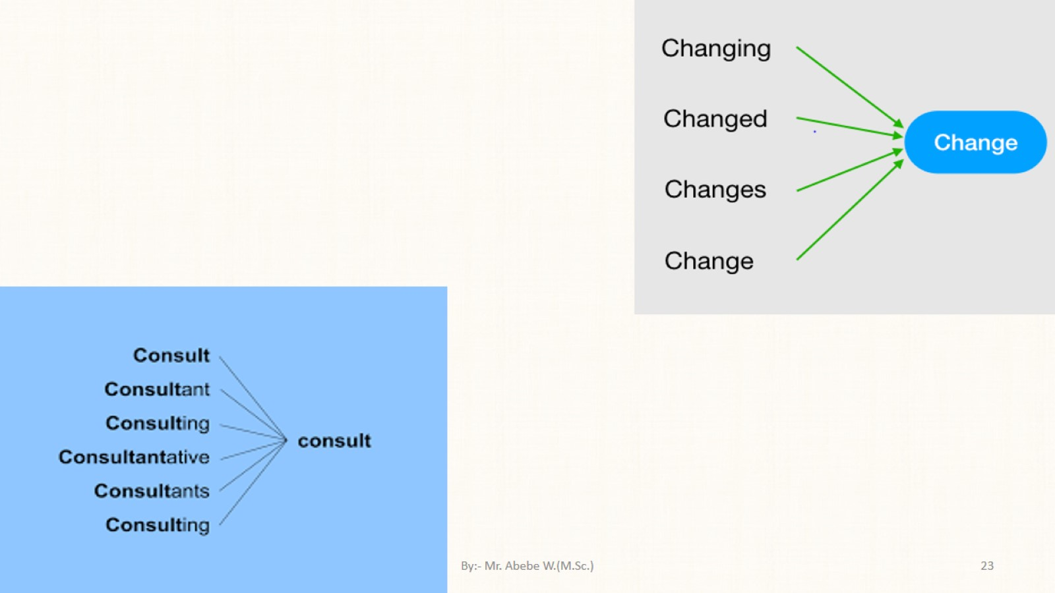

Slide 24
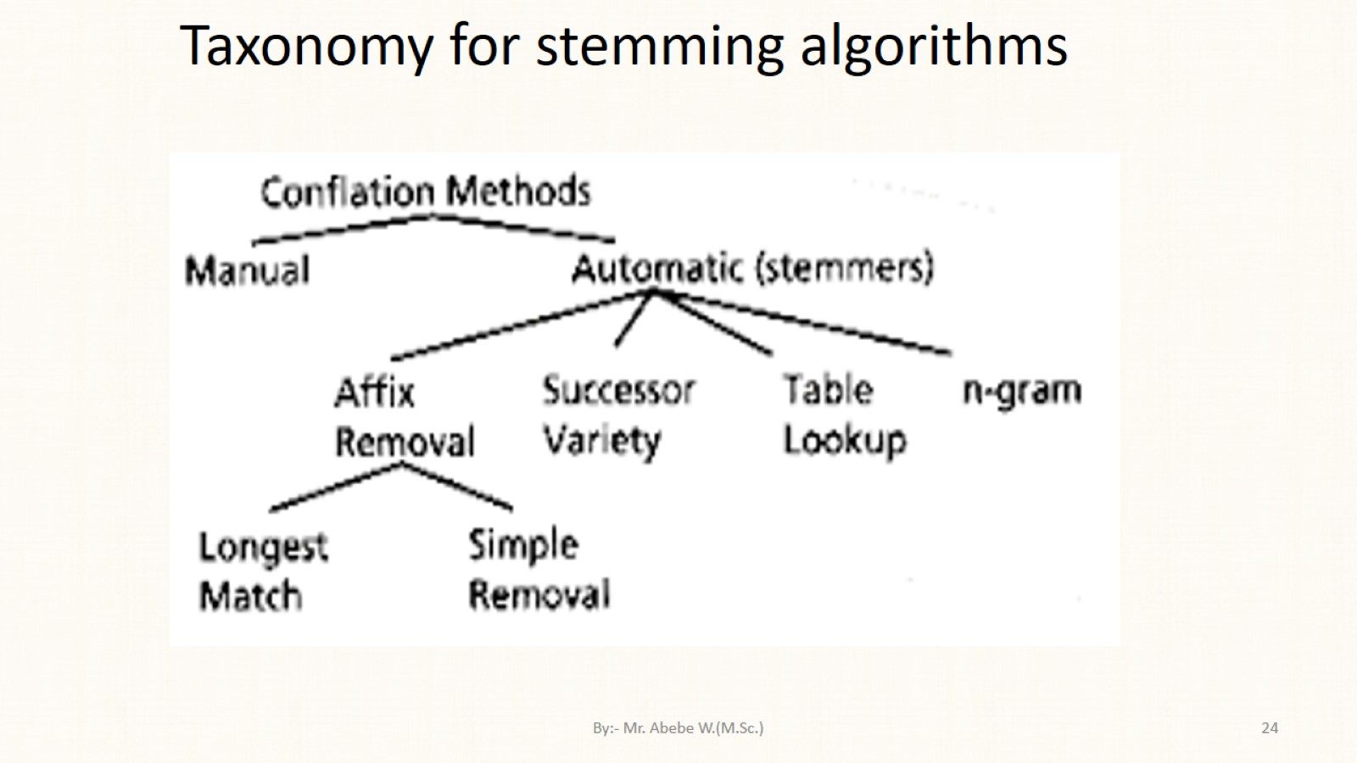
Taxonomy for stemming algorithms

Slide 25
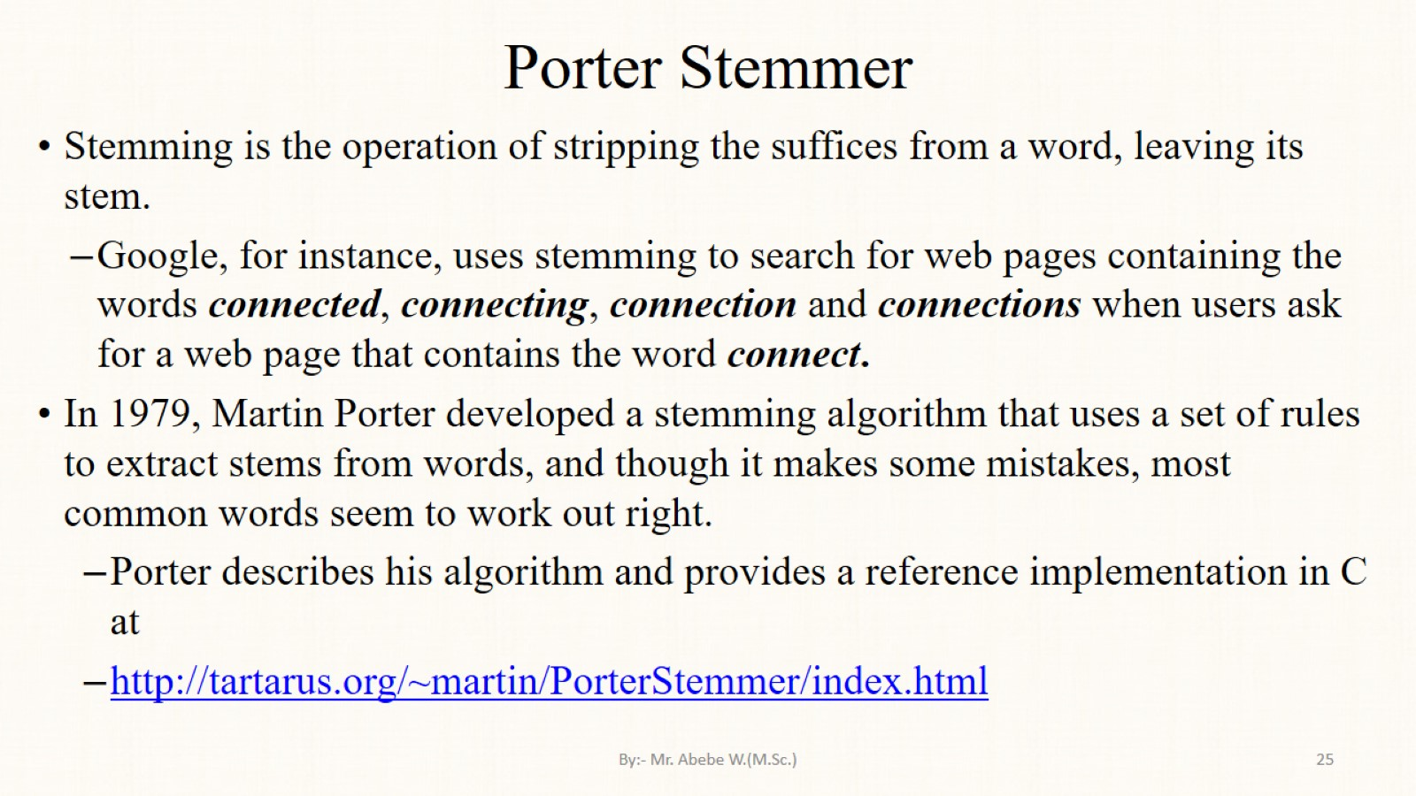
Porter Stemmer

Slide 26
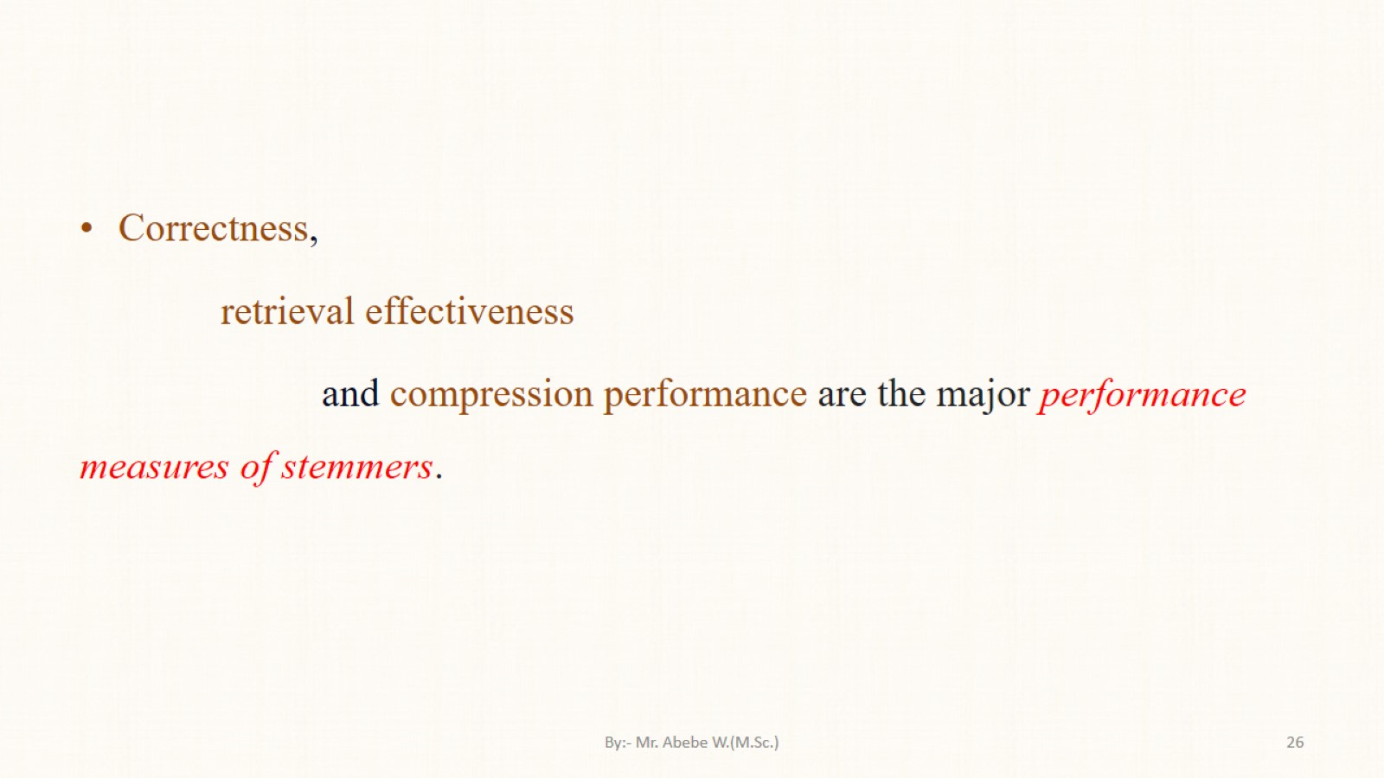

Slide 27
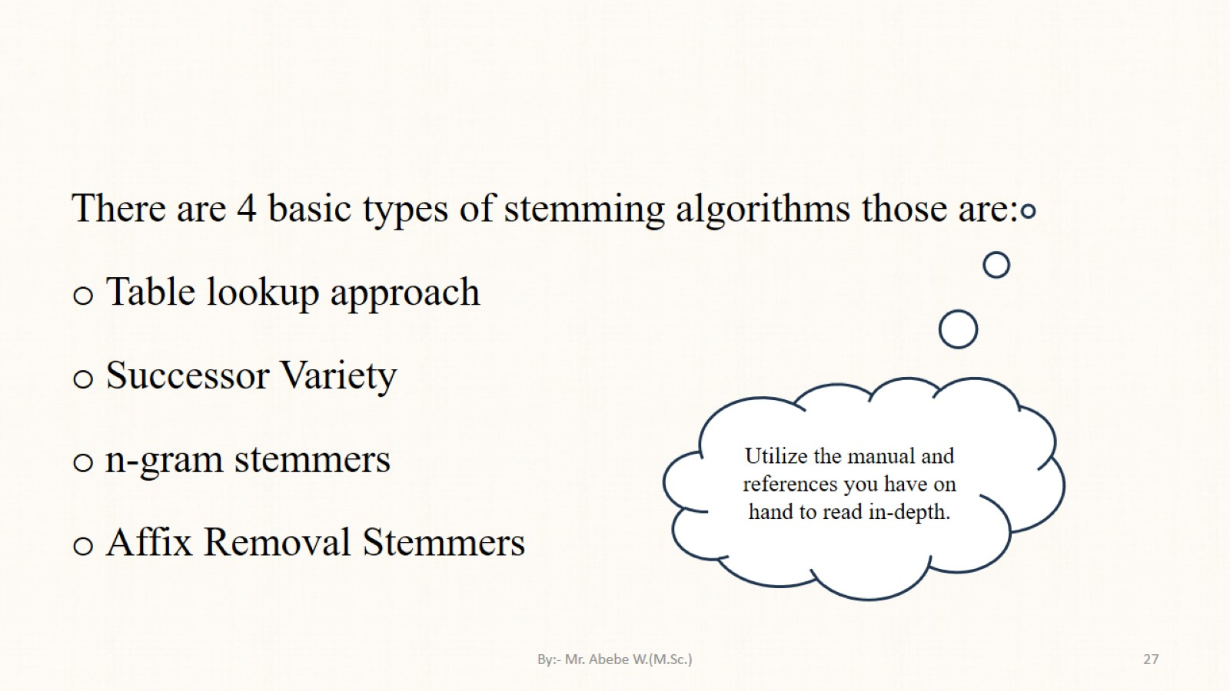

Slide 28
